Slide 1
FOOTBALL LEAGUE MANAGER USING PYTHON
UID | NAME
120IT1108A | Pawar Herschel Pravin

Slide 2
Content
Introduction
Literature survey
Motivation & Objective
System architecture
Proposed work with methodology
Software and hardware requirements

Slide 3
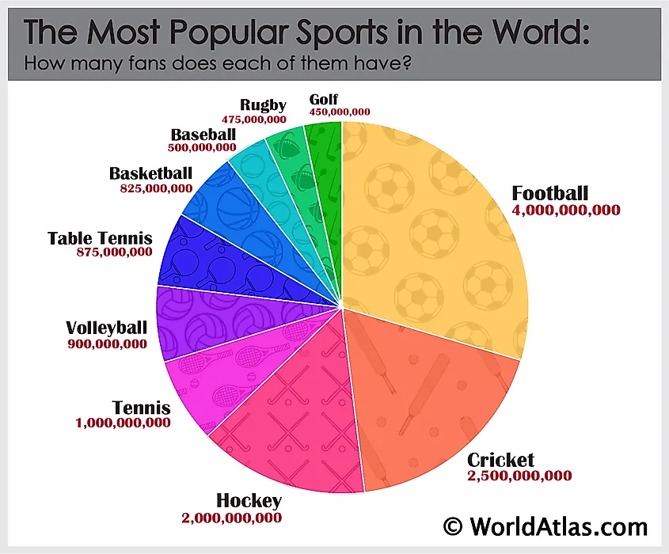
Introduction

Slide 4
Introduction
MANAGEMENT IS HARD

Slide 5
Introduction
we present you
football.sakurakat.systems
A Modern Web Based League Management Solution

Slide 6
Literature survey
TITLE | AUTHOR | AIM OF THE PAPER
Research on Sports Computer Integrated Management System Based on Network Environment under the Background of Smart Sports | Z. Cao, "Research on Sports Computer Integrated Management System Based on Network Environment under the Background of Smart Sports," 2021 IEEE Asia-Pacific Conference on Image Processing, Electronics and Computers (IPEC), 2021, pp. 1108-1111, doi: 10.1109/IPEC51340.2021.9421348. | development of computer and network technology for physical education management network systems. applied modern computer and network technology to school physical education teaching and management under the background of intelligent sports. make computer technology and network management system better developed and applied in school physical education and network management system better serve school physical education.
The Theoretical Construction and Application System Development Study of Sports Information Management | D. Jinguo, "The Theoretical Construction and Application System Development Study of Sports Information Management," 2020 IEEE International Conference on Power, Intelligent Computing and Systems (ICPICS), 2020, pp. 526-529, doi: 10.1109/ICPICS50287.2020.9202135. | In this paper, an intelligent management system is designed for college student's sports activities based on integration of various wireless technology and web services.

Slide 7
Literature survey
TITLE | Research on Sports Computer Integrated Management System Based on Network Environment under the Background of Smart Sports
AUTHOR | Z. Cao, "Research on Sports Computer Integrated Management System Based on Network Environment under the Background of Smart Sports," 2021 IEEE Asia-Pacific Conference on Image Processing, Electronics and Computers (IPEC), 2021, pp. 1108-1111, doi: 10.1109/IPEC51340.2021.9421348.
AIM OF THE PAPER | development of computer and network technology for physical education management network systems. applied modern computer and network technology to school physical education teaching and management under the background of intelligent sports. make computer technology and network management system better developed and applied in school physical education and network management system better serve school physical education.

Slide 8
Literature survey
TITLE | The Theoretical Construction and Application System Development Study of Sports Information Management
AUTHOR | D. Jinguo, "The Theoretical Construction and Application System Development Study of Sports Information Management," 2020 IEEE International Conference on Power, Intelligent Computing and Systems (ICPICS), 2020, pp. 526-529, doi: 10.1109/ICPICS50287.2020.9202135.
AIM OF THE PAPER | In this paper, an intelligent management system is designed for college student's sports activities based on integration of various wireless technology and web services.

Slide 9
Literature survey
TITLE | AUTHOR | AIM OF THE PAPER
Intelligent Management System of Sunshine Sports Activities for College Students | Y. Hui, "Intelligent Management System of Sunshine Sports Activities for College Students," 2019 International Conference on Smart Grid and Electrical Automation (ICSGEA), 2019, pp. 505-509, doi: 10.1109/ICSGEA.2019.00121. | In this paper, the application status of sports information management system is summarized properly and pointed out the flaws in the respective field.
Design Patterns and Extensibility of REST API for Networking Applications | L. Li, W. Chou, W. Zhou and M. Luo, "Design Patterns and Extensibility of REST API for Networking Applications," in IEEE Transactions on Network and Service Management, vol. 13, no. 1, pp. 154-167, March 2016, doi: 10.1109/TNSM.2016.2516946. | We understood REST API design pattern and it’s implementation

Slide 10
Literature survey
TITLE | Intelligent Management System of Sunshine Sports Activities for College Students
AUTHOR | Y. Hui, "Intelligent Management System of Sunshine Sports Activities for College Students," 2019 International Conference on Smart Grid and Electrical Automation (ICSGEA), 2019, pp. 505-509, doi: 10.1109/ICSGEA.2019.00121.
AIM OF THE PAPER | In this paper, the application status of sports information management system is summarized properly and pointed out the flaws in the respective field.

Slide 11
Literature survey
TITLE | Design Patterns and Extensibility of REST API for Networking Applications
AUTHOR | L. Li, W. Chou, W. Zhou and M. Luo, "Design Patterns and Extensibility of REST API for Networking Applications," in IEEE Transactions on Network and Service Management, vol. 13, no. 1, pp. 154-167, March 2016, doi: 10.1109/TNSM.2016.2516946.
AIM OF THE PAPER | We understood REST API design pattern and it’s implementation

Slide 12
Literature survey
TITLE | AUTHOR | AIM OF THE PAPER
Design an MVC Model using Python for Flask Framework Development | M. R. Mufid, A. Basofi, M. U. H. Al Rasyid, I. F. Rochimansyah and A. rokhim, "Design an MVC Model using Python for Flask Framework Development," 2019 International Electronics Symposium (IES), 2019, pp. 214-219, doi: 10.1109/ELECSYM.2019.8901656 | In this paper we understood how to apply model-view-controller model in our project to better organize our code

Slide 13
Literature survey
TITLE | Design an MVC Model using Python for Flask Framework Development
AUTHOR | M. R. Mufid, A. Basofi, M. U. H. Al Rasyid, I. F. Rochimansyah and A. rokhim, "Design an MVC Model using Python for Flask Framework Development," 2019 International Electronics Symposium (IES), 2019, pp. 214-219, doi: 10.1109/ELECSYM.2019.8901656
AIM OF THE PAPER | In this paper we understood how to apply model-view-controller model in our project to better organize our code

Slide 14
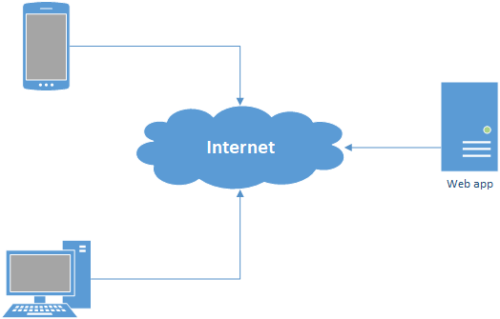

Motivation & Objective
NEW ARCHITECTURE
OLD ARCHITECTURE

Slide 15
Motivation & Objective
Convenient way to view the information about
match results
player stats
match schedule

Slide 16
Motivation & Objective
Coordinating and communicating with team
Registration for teams
Email alerts

Slide 17
Motivation & Objective
Management of
score
scheduling matches

Slide 18
System Architecture / User Types
Admin
Create Tournaments
Team Manager
Register
Verify Player Details
Anonymous
Player Stats
Update
Match Result
Player Stats
Tournament
Players
Schedule
Match Results
Check

Slide 19
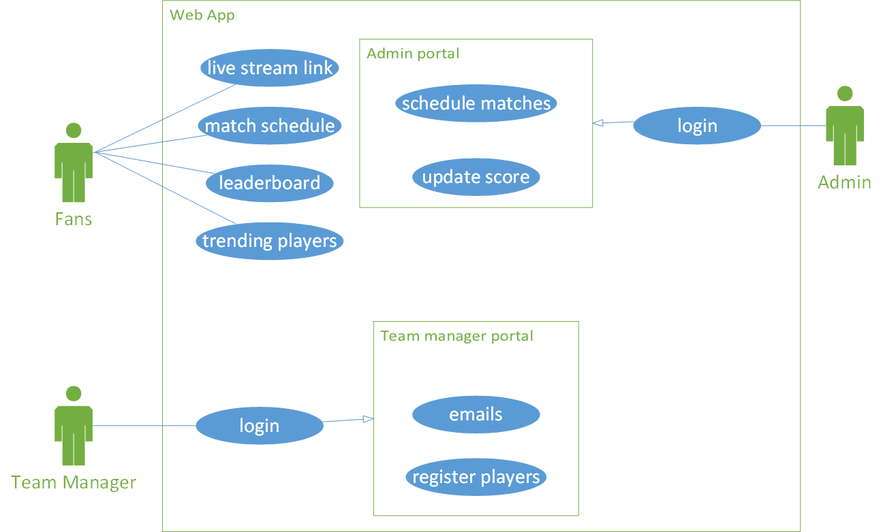
System Architecture

Slide 20
Proposed work with methodology
Make it easy to make and manage a football league by handling
Scheduling tournament
Managing a tournament can be a very hard task so this software makes it simpler and faster
Registering players
Makes it easier to keep track of team & its player’s performance
Using sql
Recording history & player stats
Allows the team and the players to improve themselves by showing them the areas they can improve upon

Slide 21
Software and hardware requirements
To use the software, the minimum requirements are
Software Requirement:
Python 3
MySql
Hardware requirements:
Windows 7
1 gigahertz (GHz) or faster 32-bit (x86) or 64-bit (x64) processor.
4 GB RAM
20 GB diskspace
Flask
Apache

